Slide 1
Nursing Process
Nursing process is the systemic framework for providing professional quality nursing care. It direct nursing activities for health promotion, health protection, and disease prevention, and is used by nurses in every practice setting and specialty.

Slide 2
The purpose of the nursing process is to provide care for client’s that is individualized, holistic, effective, and efficient.
The steps of the nursing process build upon each other, but they are not linear. There is over lab of each step with the previous and subsequent steps. The nursing process is dynamic and requires creating for its application and results will be different in each client situation.

Slide 3
The benefits of the nursing process for the nurse include self-confidence, job satisfaction, and professional growth. Benefits for the client are the potential for greater participial in their own care and continuity of quality care.

Slide 4
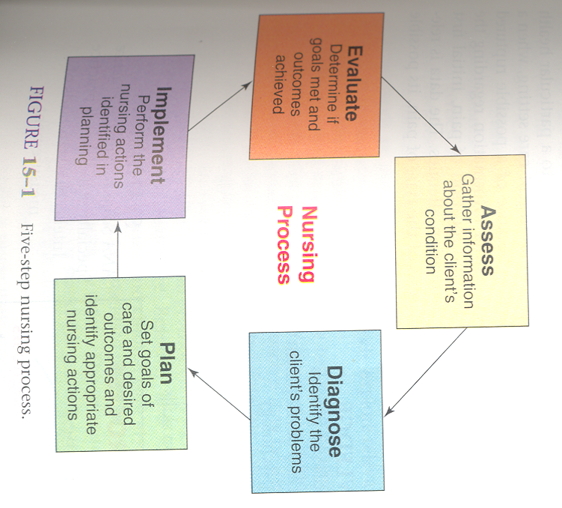

Slide 5
Nursing assessment
Nursing assessment is the deliberate and systemic collection of data to determining a client’s current and past health status and functional status and to determine the client’s present and past coping pattern.

Slide 6
What is the difference
Medical assessment focus on disease and pathology.
Nursing assessment focus on the clients responses to illness.

Slide 7
Types of assessment
Initial
Ongoing
Comprehensive
Focusing
Special needs( pain, nutritional, psychosocial …)

Slide 8
Nursing assessment includes:
The first step involves the collection and verification of data from a primary source (the clients) and secondary source (family, health professionals, and medical records).
The second steps involve the analysis of all data as a basis for developing nursing diagnosis and an individualized plan of care for the clients. The purpose of assessment is to establish a database about the client’s perceived need, health problem, and responses to these problems. In addition, the data reveal related experiences, health practice, goals, values, and expectations held about the health care system.

Slide 9
Data are collecting from a verity of sources:
Primary sources:
The client should be considered the major provider of information about self by using both interview technique and physical examination skills.
Secondary sources:
Include family members, other health care provider, and medical records and diagnostic reports.

Slide 10
Types of data
Subjective data:
Are data from the client’s point of view and include feelings, perceptions, and concerns.
Objective data:
Are observable and measurable data that are obtained through both standard assessment technique performed during the physical examination and diagnostic tests.

Slide 11
Methods of data collection
A-Interview:
The first step in establishing the data base is to collect subjective information by interviewing the client. Interview is an organized conversation with the client to obtain the client's health history and information about the current illness.

Slide 12
Phases of interview
orientation phase
working phase
termination phase

Slide 13
Types of techniques
Open-ended question
Closed-ended question
Back channeling
Problem seeking
B-Physical examination

Slide 14
Question
Q : Which of the following is a example of an open – ended question ?
1. can you tell me where it hurts?
2. what do you want to do now?
3. what kinds of satiations trigger your anxiety?
4. when did this happen?

Slide 15
2- Nursing diagnosis
The second step in nursing process involves further analysis (breaking the whole down into parts that can be examined) and synthesis (putting data together in a new way) of the data that have been collected .
Nursing diagnosis is a clinical judgment about individual, family, or community responses to actual or potential health problem/ life process.
Types of nursing diagnosis
Actual nursing diagnosis: Indicates that problem exists, and is composed of the diagnostic label, related factors, and signs and symptoms.
2- A risk nursing diagnosis (potential problem): Indicates that a problem does not yet exist, but special risk factors are present.
3- A possible nursing diagnosis: indicates a situation in which a problem could arise unless preventive action is taken.
4- A wellness nursing diagnosis: indicates the client’s expression of a desire to attain a higher level of wellness in some area of function.
Collaborative problem: are defined as physiological complication monitored by nurses to assess changes in client status.

Slide 16
The purpose of this stage is to identify the patient's nursing problems.
Nursing diagnosis : a statement that describe a specific human response to an actual or potential health problem that requires nursing intervention.
Written in PE format
P= problem: use (NANDA)
Due to or related to(r/t)
E= etiology: cause of problem
Manifested by(m/b) = (sings and symptoms)

Slide 17
EXAMPLE
Problem
deficient fluid volume, r/t diarrhea, m/b dry skin, dryness of mouth

Slide 18
3- Nursing planning
Is the third step of the nursing process and includes the formation of guidelines that establish the proposed course of nursing action in the resolution of nursing diagnosis and the development of the client’s plan of care.
The planning phase involves several tasks:
The list of nursing diagnosis is prioritized. The nurse gives the diagnosis involving life- threatening situations the highest priority.
Client- centered long and short- term goals and outcomes are identified and written.
Specific interventions are developed.
The entire plan of care is recorded in the client’s record.

Slide 19
4- Nursing implementation
With the care plan based on clear and relevant nursing diagnosis, the nurse selects and initiates interventions that are most likely to support or improve the client health status.
Implementation is the step of nursing process where nurses provide care to patients. The nurse initiates and completes actions or intervention necessary for achieving the goals and expected outcomes of nursing care.
A nursing intervention is any treatment, based upon clinical judgment and knowledge that a nurse performs to enhance client outcomes.
Intervention includes both direct and indirect care.
Notes:
Direct care interventions are treatments performed interaction with the client. (Example, administration of medication, IV fluid).Indirect care interventions are treatments performed away from the client but on behalf of the client or group of clients (Example. managing the client’s environment (safety and infection control), documentation).

Slide 20
Factors should be considered when choosing intervention:
Desired or expected client outcome.
Characteristics of nursing diagnosis.
Evidence base for the intervention.
Feasibility for performing an intervention.
Acceptability to the client.
Capability of the nurse.

Slide 21
5- Nursing evaluation
The fifth step in the nursing process, involves determining whether the client goals have been met, partially met, or not met. If the goals have been met, the nurse must then decide whether nursing activities well cease or continue in order for status to be maintained. If the goals has been partially met or not been met, the nurse must reassess the situation. Data are collected to determine why the goals have not been achieved and what modifications to the plan of care are necessary. There are a number of possible reasons that goals are not met or are only partially met, include:
The initial assessment data were incomplete.
The goals and expected outcomes were not realistic.
The time frame was too optimistic.
The goals and/ or the nursing interventions planned were not appropriate for the client.

